Slide 1
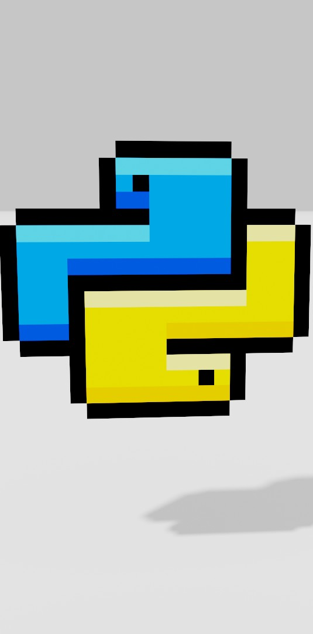
Python Mini-Project
COMPUTER ENGINEERING DEPARTMENT
Blockchain using Python.
ARYAN KUMAR (20102017)
JANVI MEHTA (20102187)
Guide :
(Prof. Shraddha Shinde)

Slide 2
01
ABSTRACT
➔In this project, we have made a simple Blockchain using the python language and FastAPI. A blockchain and its functions are created using methods. It can be used as a ledger where users can store transactions, real estate dealings, and any other kind of transaction.
➔The data is encrypted using the SHA-256 algorithm. It’s a cryptographic hash (sometimes called 'digest') a kind of 'signature' for a text or a data file. SHA-256 generates an almost-unique 256- bit (32-byte) signature for a text. The data is first clubbed with proof and index which is then put into a formula that is then been encrypted. The algorithm provides us the hash which can be used for verification of the block.
➔Every block also has a proof of work. Proof of work (PoW) is a decentralized consensus mechanism that requires members of a network to expend effort solving an arbitrary mathematical puzzle to prevent anybody from gaming the system. It has functions such as mining the block, validating the block, and getting the blockchain. It displays the working of a blockchain and its components like timestamp, PoW, index, and hash. Once mined, the block is added to the blockchain at the next index.

Slide 3
PROBLEM DEFINITION
02
➔This blockchain can be used as an immutable ledger that facilitates the process of recording transactions and tracking assets in a business network. An asset can be tangible (a house, car, cash, land) or intangible (intellectual property, patents, copyrights, branding).
➔ It can also be used to study the working of blockchains as it contains most of the features of a cryptocurrency blockchain.

Slide 4
INTRODUCTION
03
➔The blockchain is an open and distributed ledger. It uses an append-only data structure, meaning new transactions and data can be added to a blockchain, but past data cannot be erased. This results in a verifiable and permanent record of data and transactions between two or more parties.
➔Anything from currencies to land titles to votes can be tokenized, stored, and exchanged on a blockchain network. The idea of blockchain technology for real estate administration is being actualized within land registry projects globally to further the efficiency of land and house registries. This idea is to diminish the threat of losing Important data and to provide the best security for it.

Slide 5
MODULES
04
There are four modules:
1) Mine Block:
Here you can enter your transaction and mine the block. The block will then be added to the blockchain
consisting of the index, timestamp, data, proof, and previous hash.
2) Get Blockchain:
Here you can see the entire blockchain as a JSON file.
3) Validate:
Here you can check whether the block is valid or not. It checks if the previous hash of the current block is
the same as the hash of the previous block.
4) Previous Block:
Here you can get the latest block created in your blockchain.

Slide 6
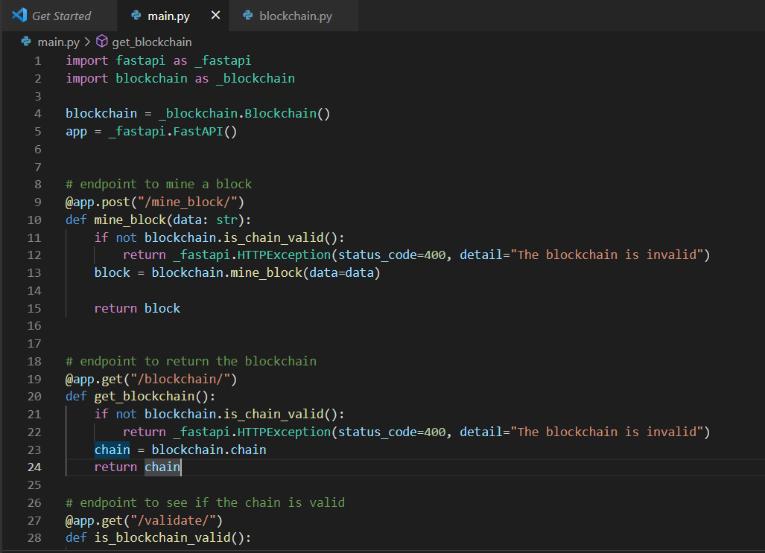
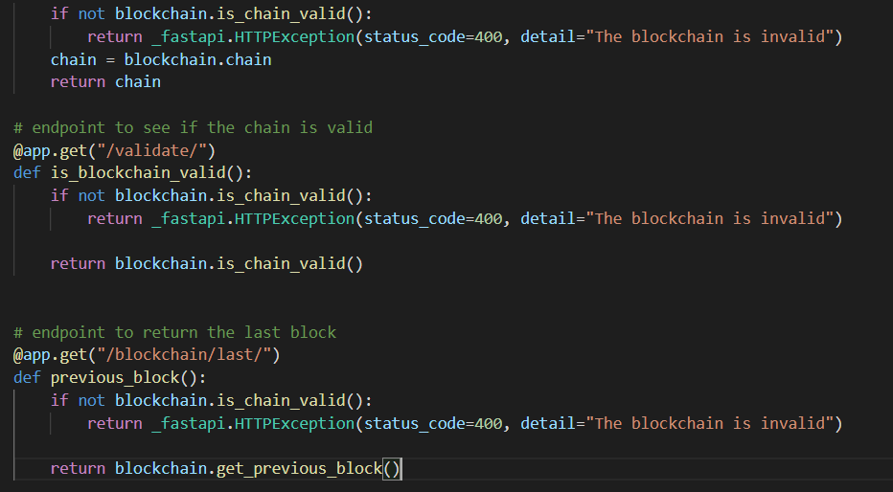
IMPLEMENTATION
05
CODE:

Slide 7
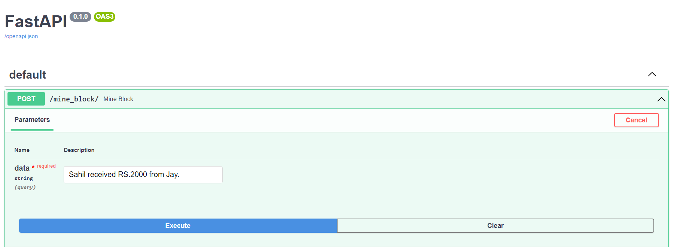
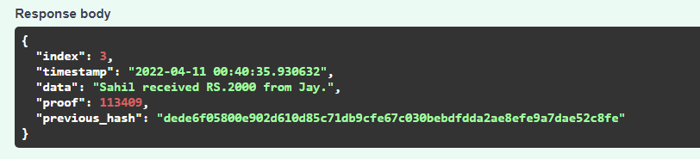
OUTPUT :
1) MINE BLOCK:

Slide 8
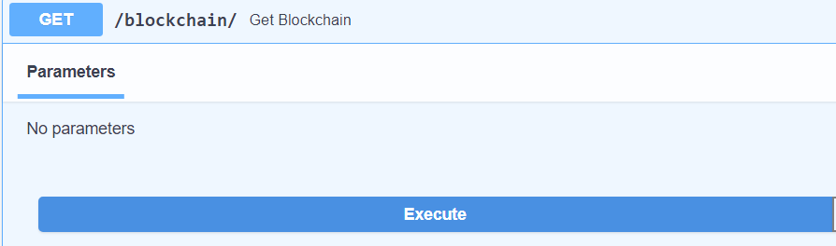
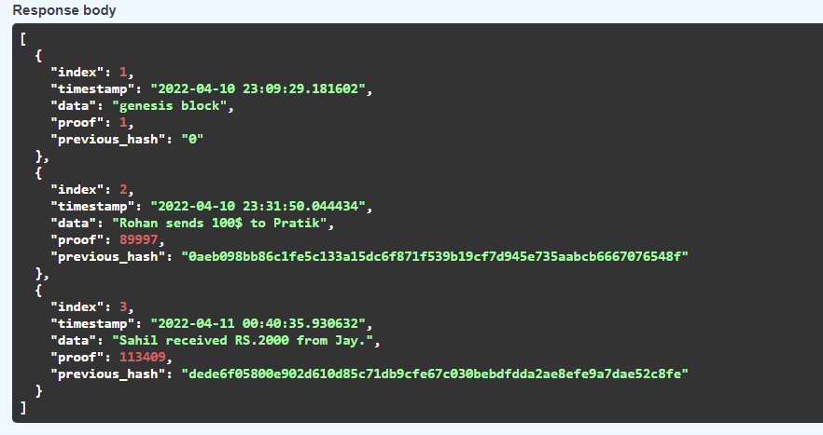
2) GET BLOCKCHAIN:

Slide 9
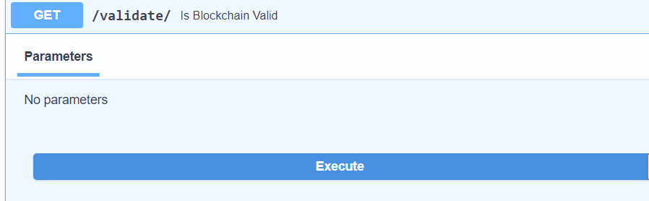
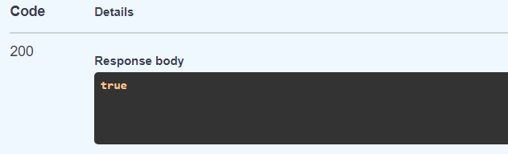
3) VALIDATE:

Slide 10
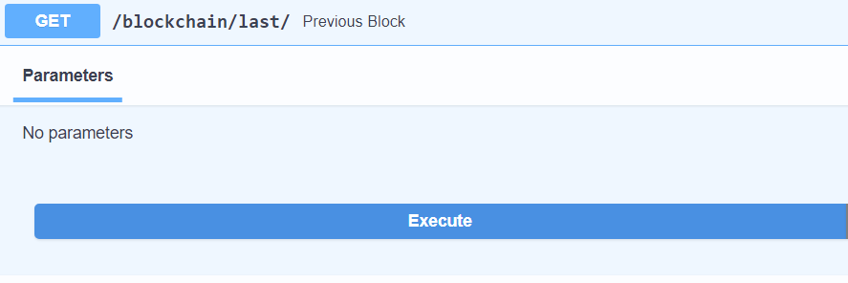
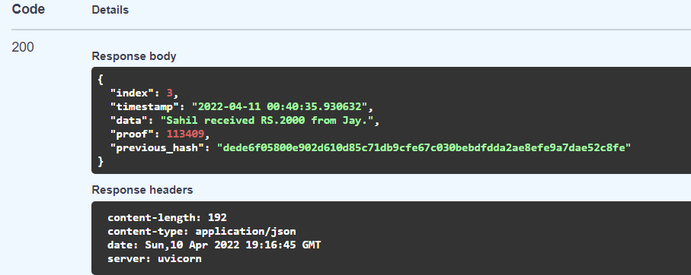
4) PREVIOUS BLOCK:

Slide 11
CONCLUSION FUTURE SCOPE
➔ This project is the successful implementation of blockchain in the field of immutable transactions as the world has found applications of blockchain technology in several industries, where trust without the involvement of centralized authority is desired.
➔It is expected that blockchain will expand its scope of usability in many more sectors including finance, data analysis, and the Internet of Things with the advent of 5G. Usage of the Blockchain system in different sectors apart from cryptocurrencies and NFTs can easily save time, money and solve many problems.

Slide 12
REFERENCES
1) Mishra, I., Supriya, Sahoo, A., & Vivek Anand, M. (2021). Digitalization of Land Records using Blockchain Technology. 2021 International Conference on Advance Computing and Innovative Technologies in Engineering (ICACITE). doi:10.1109/icacite51222.2021.9404678
2) Di Pierro M. What is the blockchain?. Computing in Science & Engineering. 2017 Sep 1;19(5):92-5.
3) https://www.activestate.com/blog/how-to-build-a-blockchain-in-python/
4) https://www.codecademy.com/learn/introduction-to-blockchain/modules/blockchain-in-python
5) https://www.section.io/engineering-education/how-to-create-a-blockchain-in-python/

Slide 13
ACKNOWLEDGEMENT
I would like to express my gratitude towards Prof. Tanvi Kapade and Prof. Shraddha Shinde for guiding me throughout the project and stimulating suggestions and encouragement, which really helped us in completing this project and writing this report.

Slide 14
THANK YOU

